Slide 1
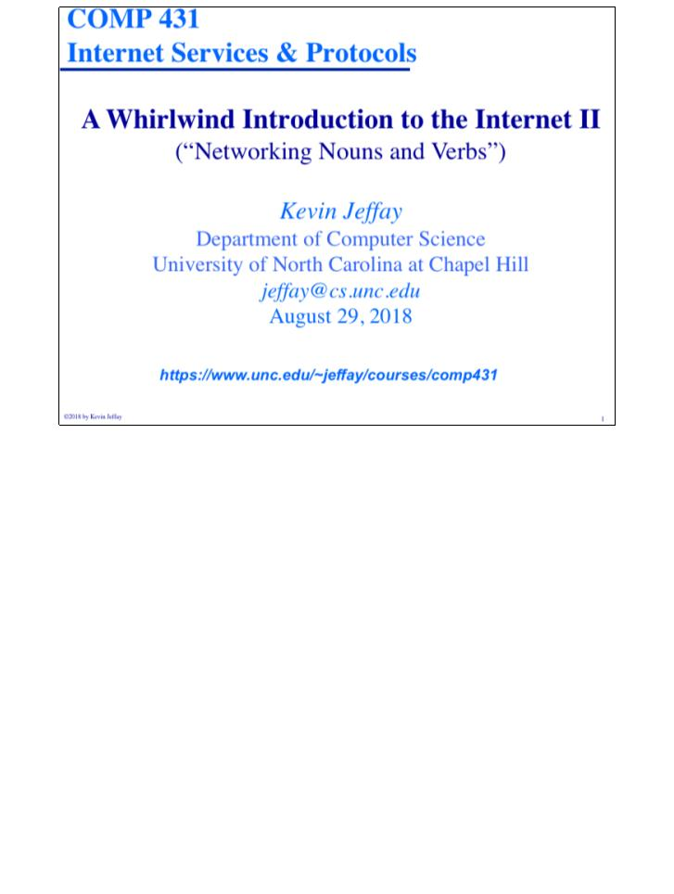
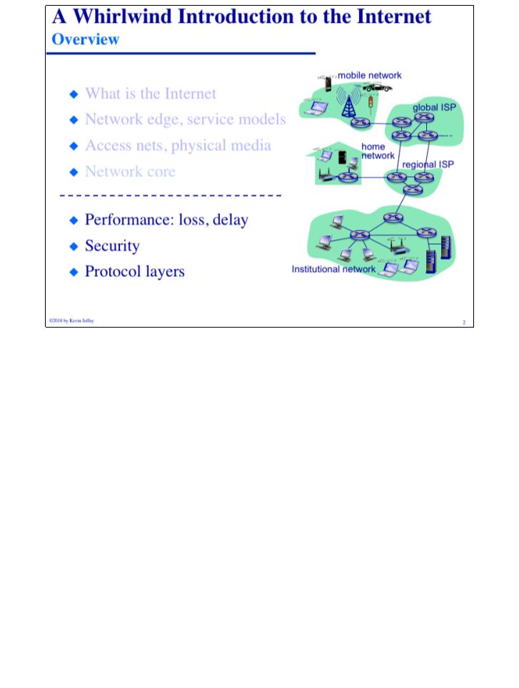
COMP 431
© 2018 by Kevin Jeffay
Lecture 2, Whirlwind Intro II
August 29, 2018
Page 1
COMP 431
© 2018 by Kevin Jeffay
Lecture 2, Whirlwind Intro II
August 29, 2018
Page 2

Slide 2
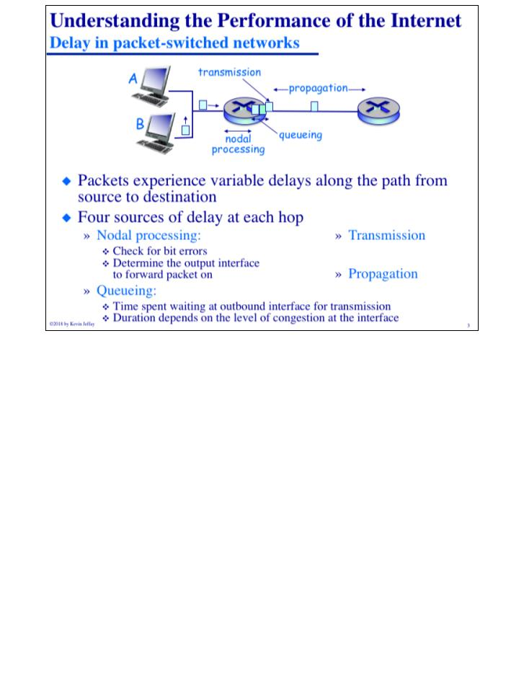
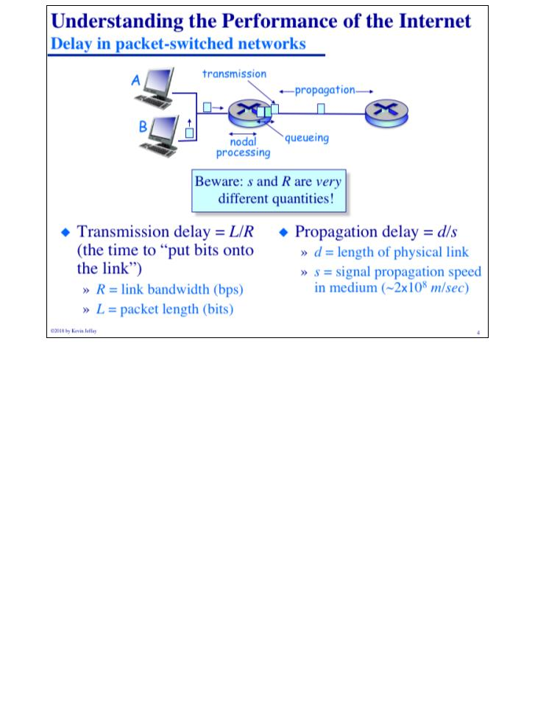
COMP 431
© 2018 by Kevin Jeffay
Lecture 2, Whirlwind Intro II
August 29, 2018
Page 3
COMP 431
© 2018 by Kevin Jeffay
Lecture 2, Whirlwind Intro II
August 29, 2018
Page 4
Notes:
Nodal Processing = Table Lookup, Queueing = Waiting to be transmitted, Transmission = time to put bits onto link, Propogation = moving the binary 1s and 0s at the speed of light

Slide 3
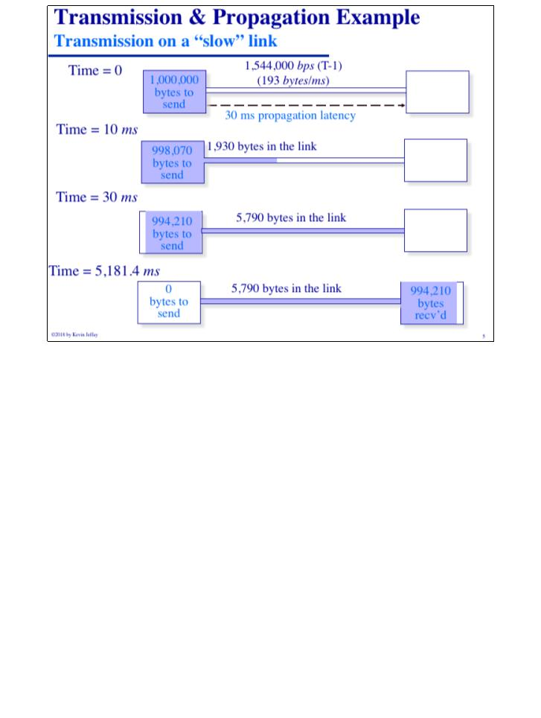
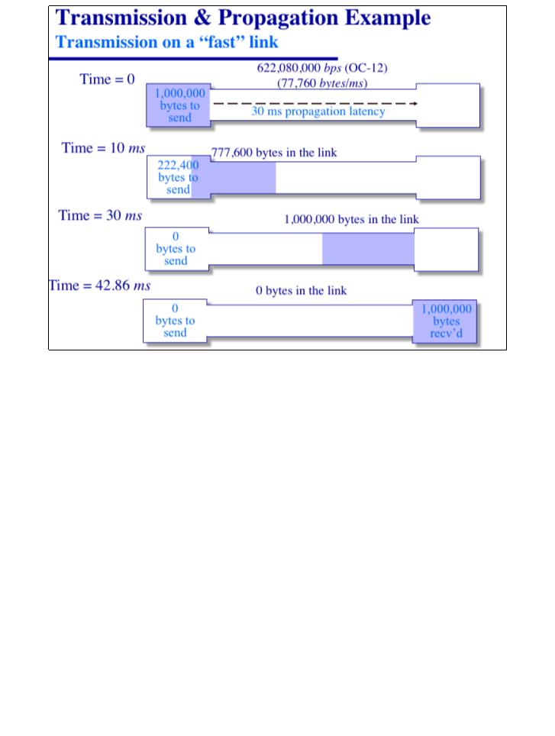
COMP 431
© 2018 by Kevin Jeffay
Lecture 2, Whirlwind Intro II
August 29, 2018
Page 5
COMP 431
© 2018 by Kevin Jeffay
Lecture 2, Whirlwind Intro II
August 29, 2018
Page 6
Notes:
Notice that the propogation delay is exactly the same because the distance across the country is the same, regardless of how fast the link transmits the data.

Slide 4
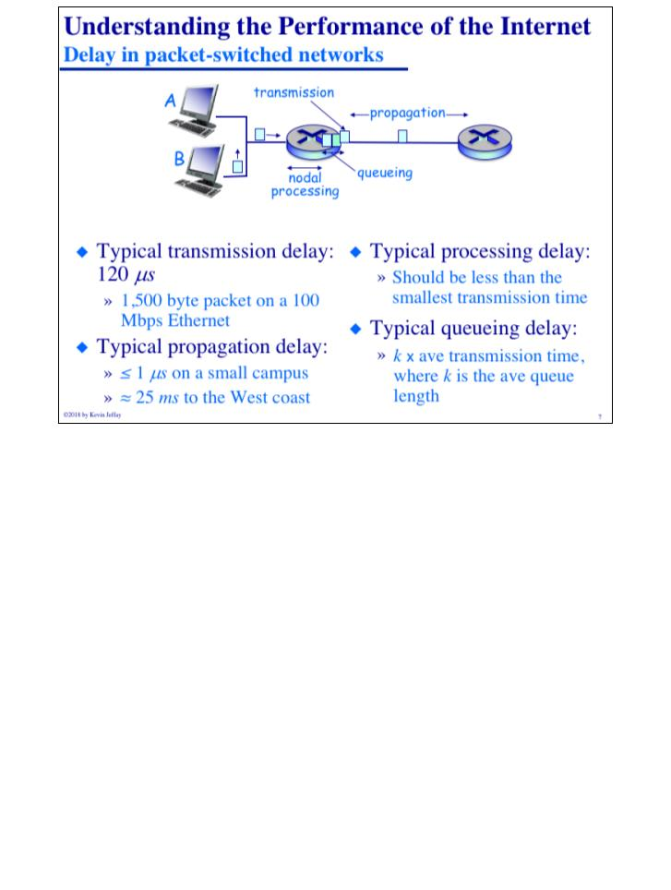
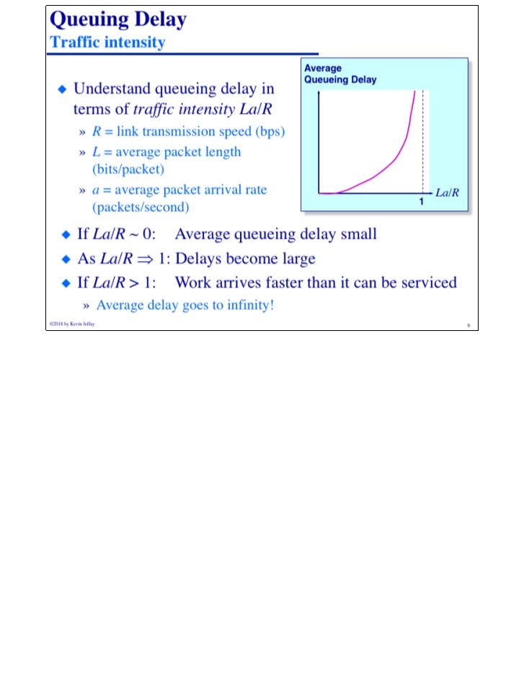
COMP 431
© 2018 by Kevin Jeffay
Lecture 2, Whirlwind Intro II
August 29, 2018
Page 7
COMP 431
© 2018 by Kevin Jeffay
Lecture 2, Whirlwind Intro II
August 29, 2018
Page 9
Notes:
Processing delay has to be less than the transmission delay because you can’t then form a queue since your’e tranismitting your queue out before you can even process your lookup table.

Slide 5
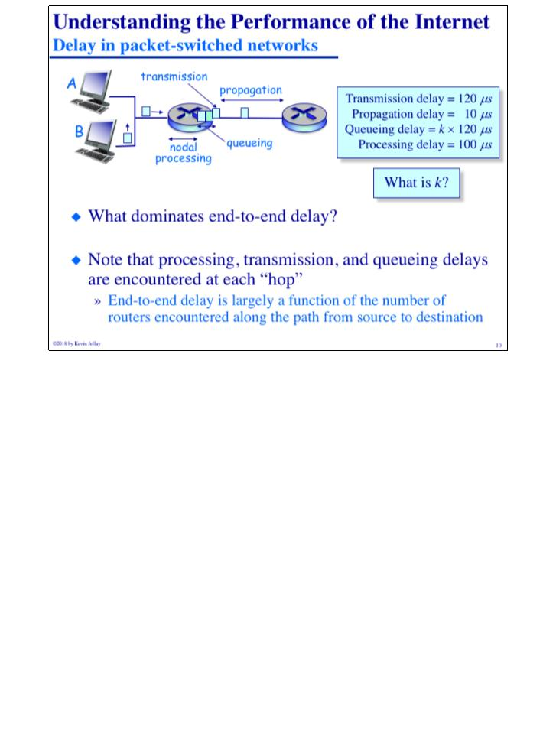
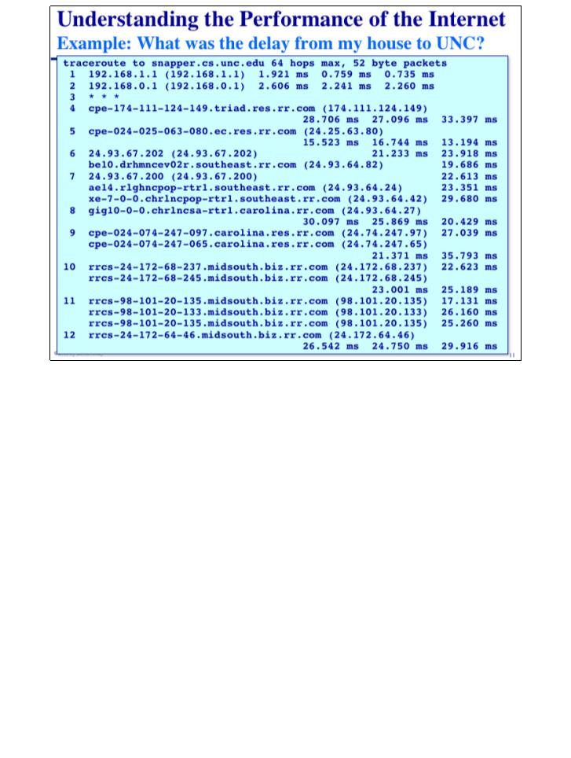
COMP 431
© 2018 by Kevin Jeffay
Lecture 2, Whirlwind Intro II
August 29, 2018
Page 10
COMP 431
© 2018 by Kevin Jeffay
Lecture 2, Whirlwind Intro II
August 29, 2018
Page 11

Slide 6
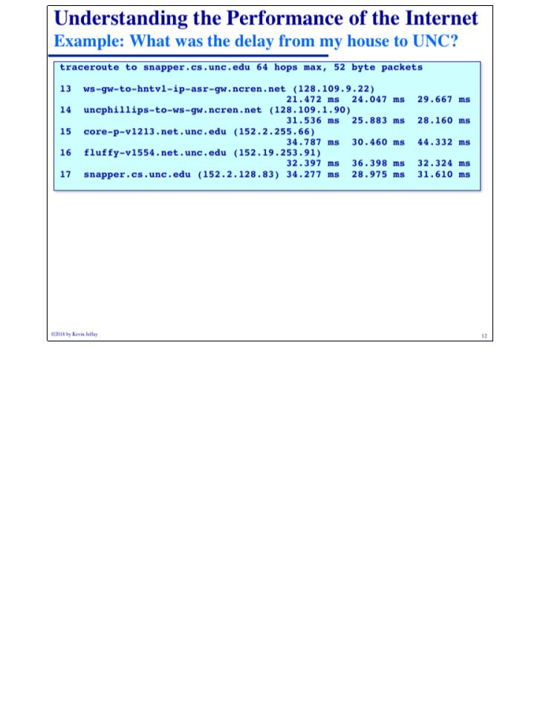
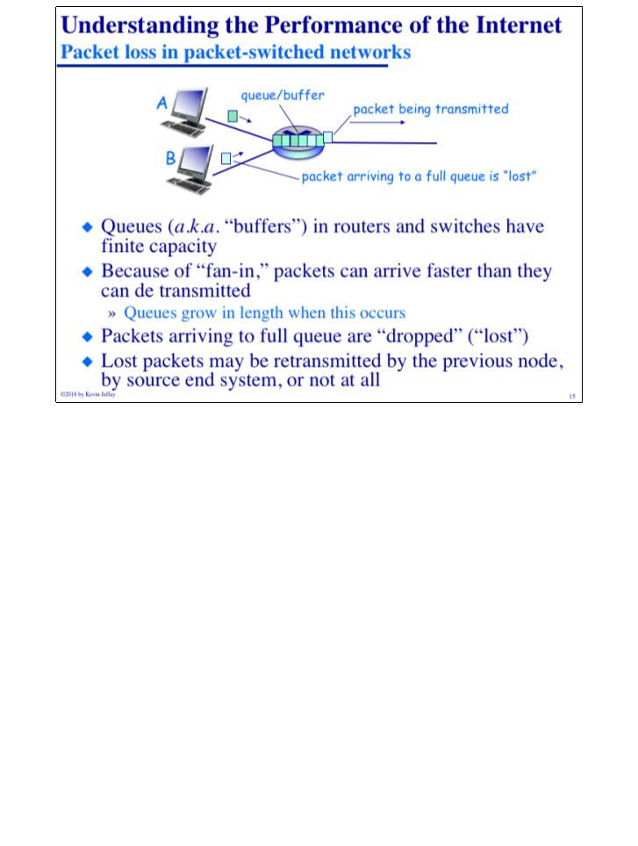
COMP 431
© 2018 by Kevin Jeffay
Lecture 2, Whirlwind Intro II
August 29, 2018
Page 12
COMP 431
© 2018 by Kevin Jeffay
Lecture 2, Whirlwind Intro II
August 29, 2018
Page 15

Slide 7
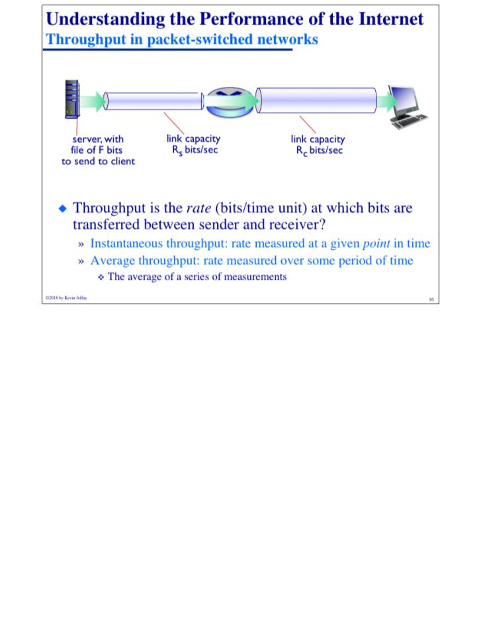
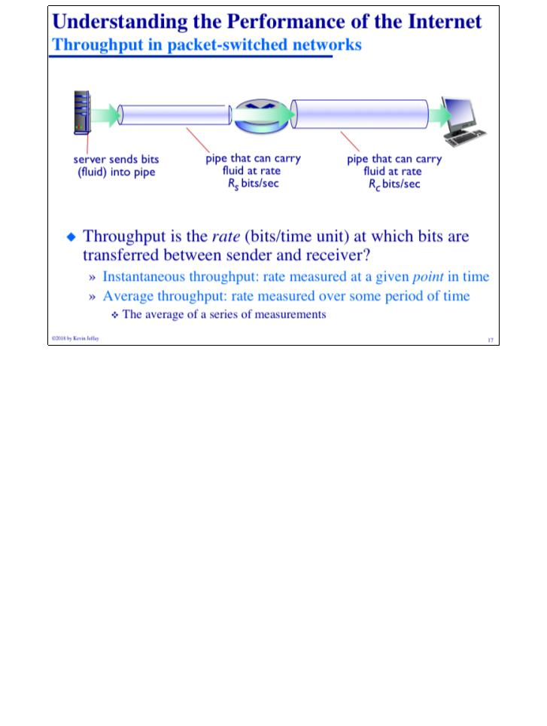
COMP 431
© 2018 by Kevin Jeffay
Lecture 2, Whirlwind Intro II
August 29, 2018
Page 16
COMP 431
© 2018 by Kevin Jeffay
Lecture 2, Whirlwind Intro II
August 29, 2018
Page 17

Slide 8
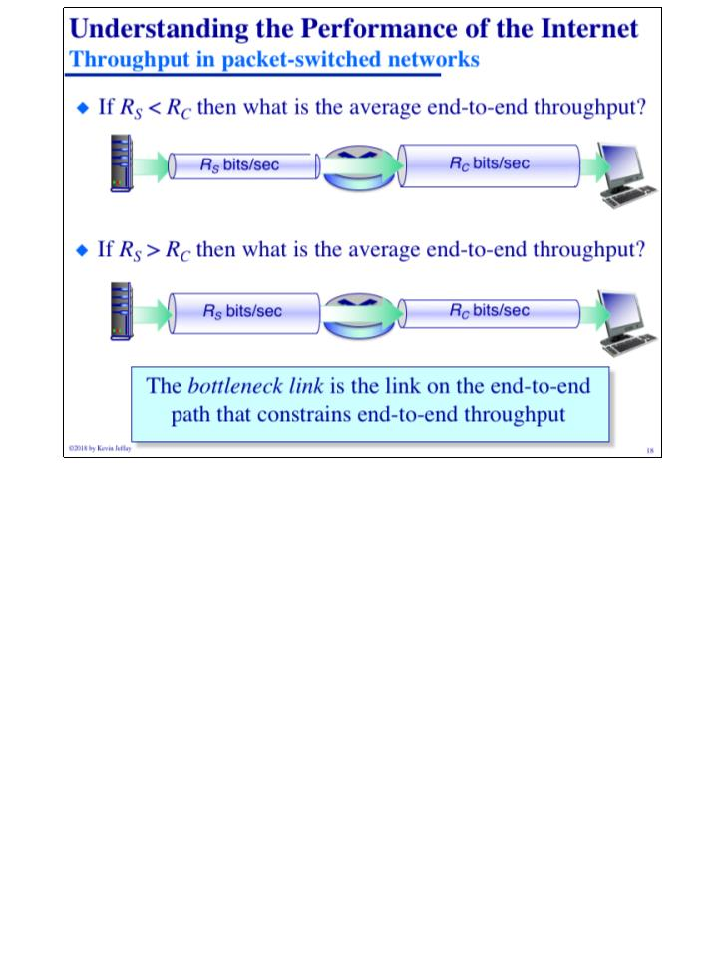

COMP 431
© 2018 by Kevin Jeffay
Lecture 2, Whirlwind Intro II
August 29, 2018
Page 18
COMP 431
© 2018 by Kevin Jeffay
Lecture 2, Whirlwind Intro II
August 29, 2018
Page 20

Slide 9
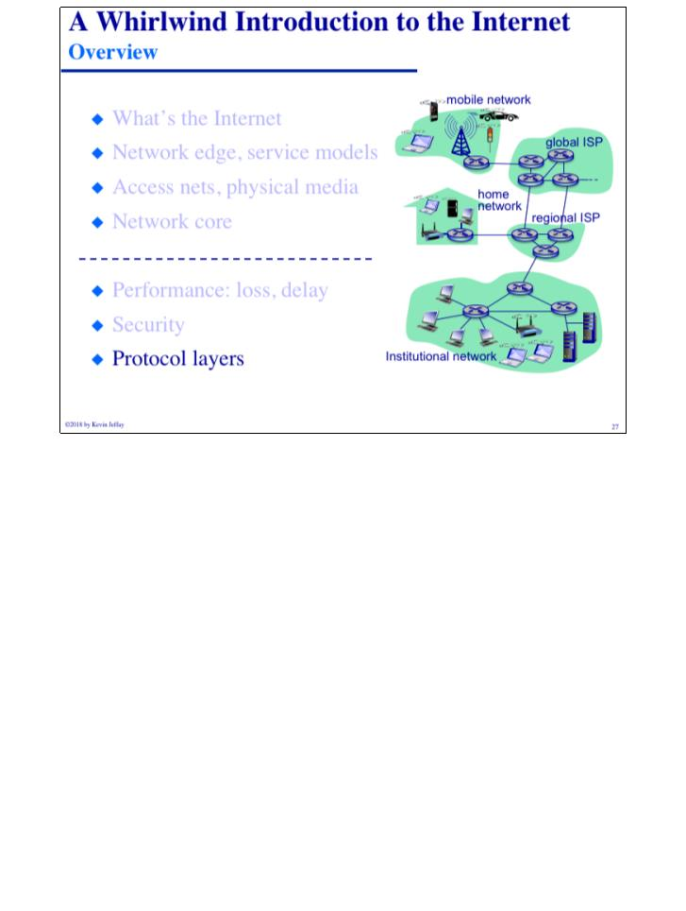
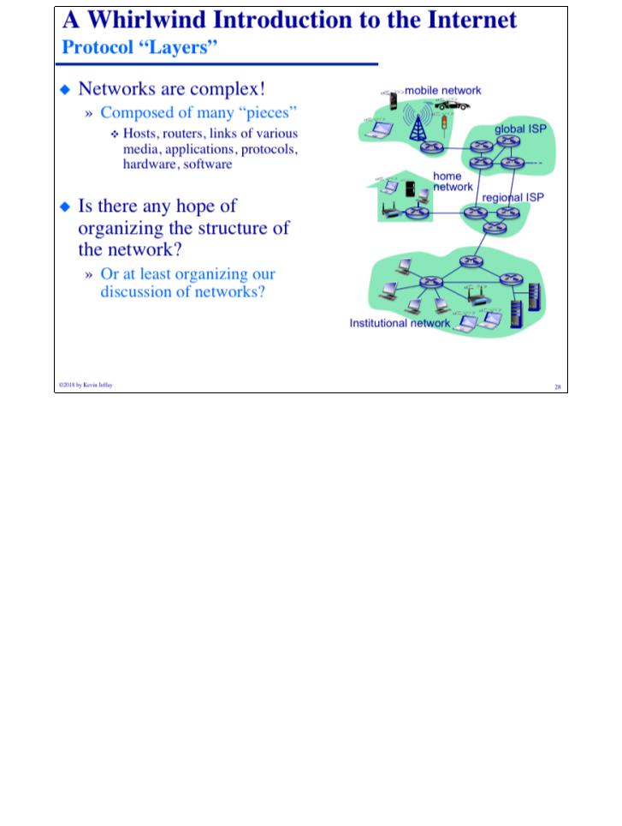
COMP 431
© 2018 by Kevin Jeffay
Lecture 2, Whirlwind Intro II
August 29, 2018
Page 27
COMP 431
© 2018 by Kevin Jeffay
Lecture 2, Whirlwind Intro II
August 29, 2018
Page 28

Slide 10
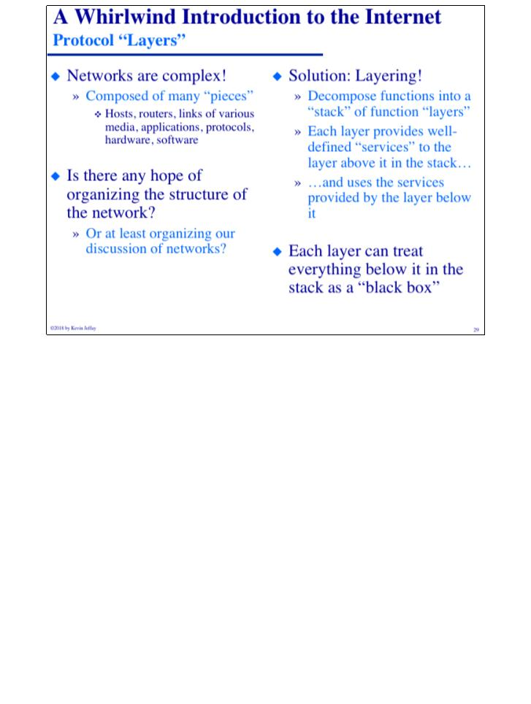
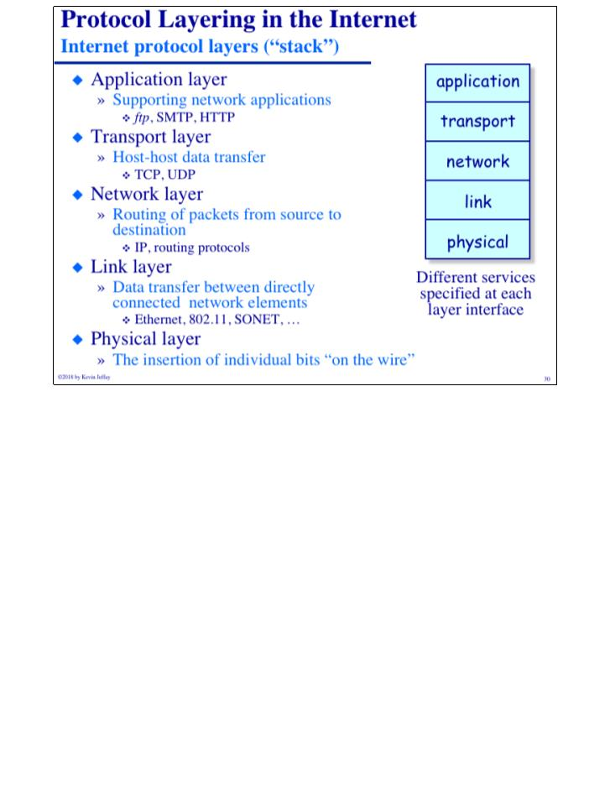
COMP 431
© 2018 by Kevin Jeffay
Lecture 2, Whirlwind Intro II
August 29, 2018
Page 29
COMP 431
© 2018 by Kevin Jeffay
Lecture 2, Whirlwind Intro II
August 29, 2018
Page 30
Notes:
Lower layers are closer to the hardware, higher layers are closer to the user. The lowest ones are like the parent interfaces. These layers are solely about where the protocols belong.

Slide 11
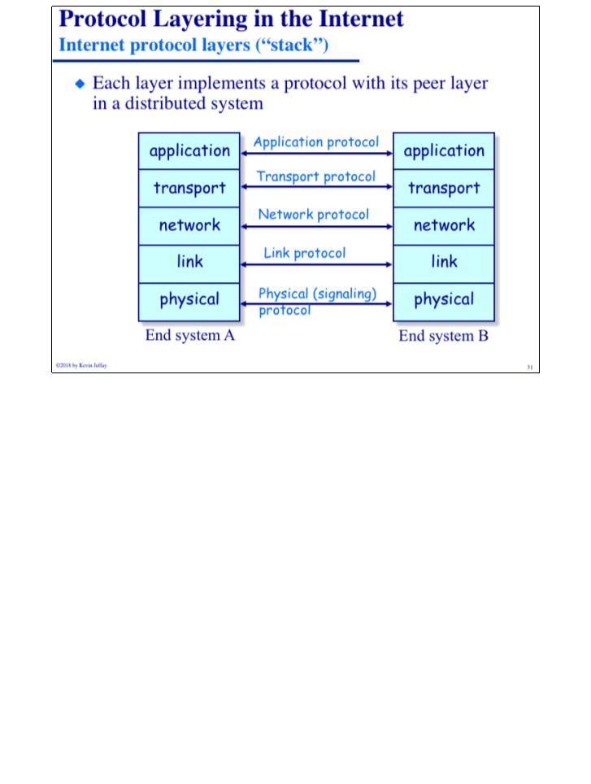
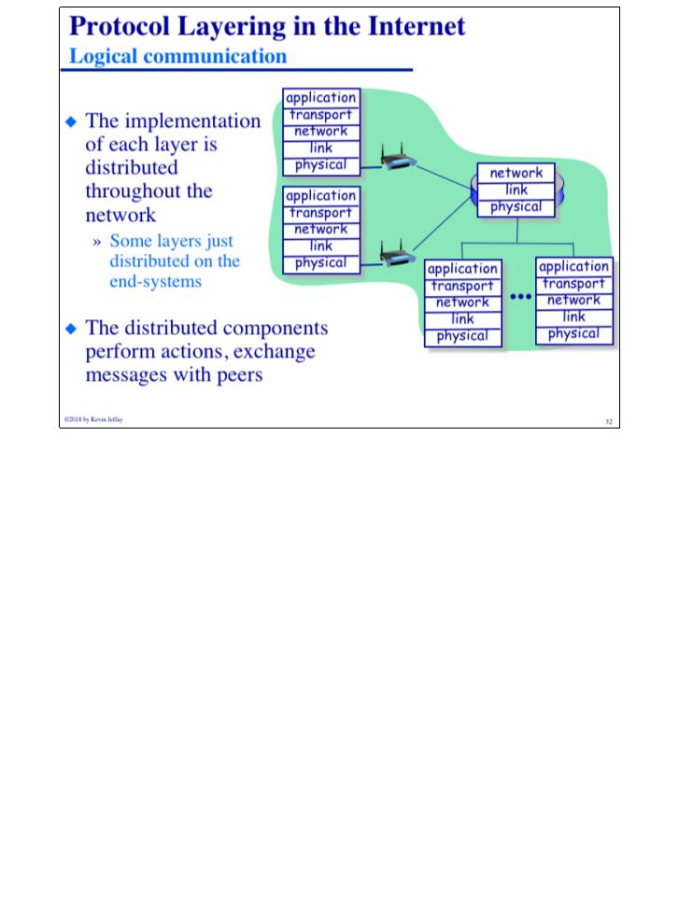
COMP 431
© 2018 by Kevin Jeffay
Lecture 2, Whirlwind Intro II
August 29, 2018
Page 31
COMP 431
© 2018 by Kevin Jeffay
Lecture 2, Whirlwind Intro II
August 29, 2018
Page 32
Notes:
Some tings don’t have all the layers. Routers, for example, only have up to the network layer, so they have no idea what TCP, UDP, SMTP, or HTTP is.

Slide 12
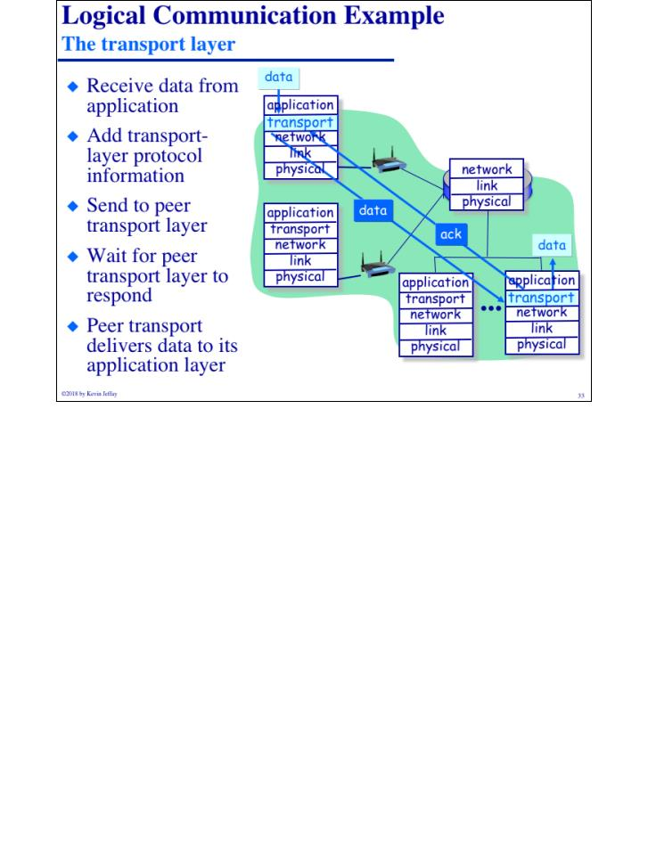
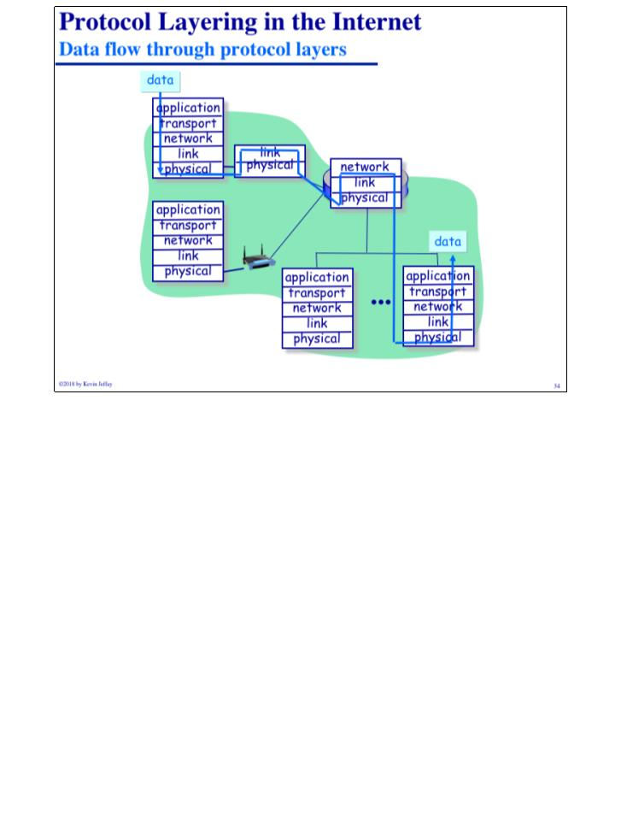
COMP 431
© 2018 by Kevin Jeffay
Lecture 2, Whirlwind Intro II
August 29, 2018
Page 33
COMP 431
© 2018 by Kevin Jeffay
Lecture 2, Whirlwind Intro II
August 29, 2018
Page 34

Slide 13
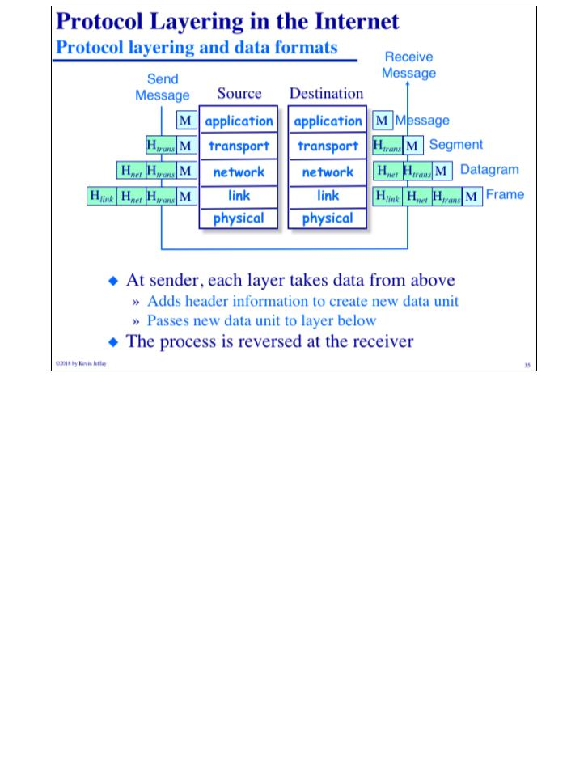
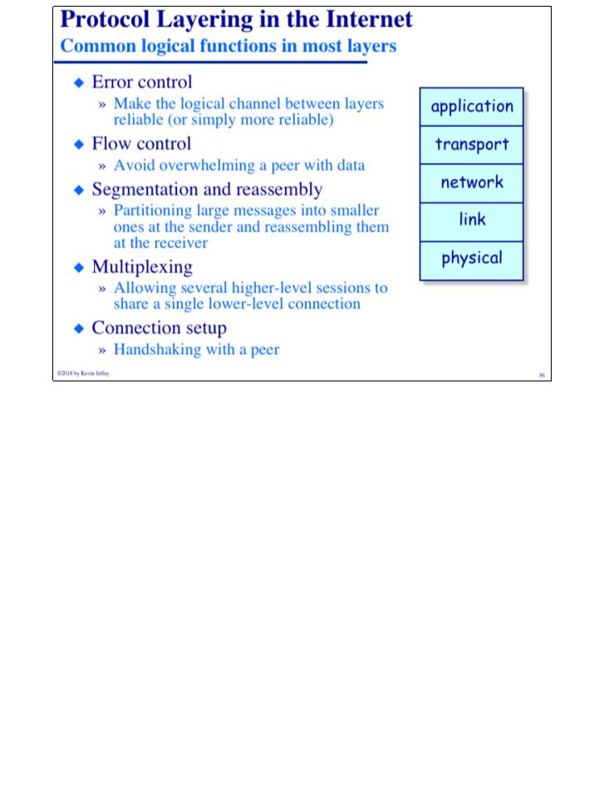
COMP 431
© 2018 by Kevin Jeffay
Lecture 2, Whirlwind Intro II
August 29, 2018
Page 35
COMP 431
© 2018 by Kevin Jeffay
Lecture 2, Whirlwind Intro II
August 29, 2018
Page 36
Notes:
H stands for header, m is for message

Slide 14
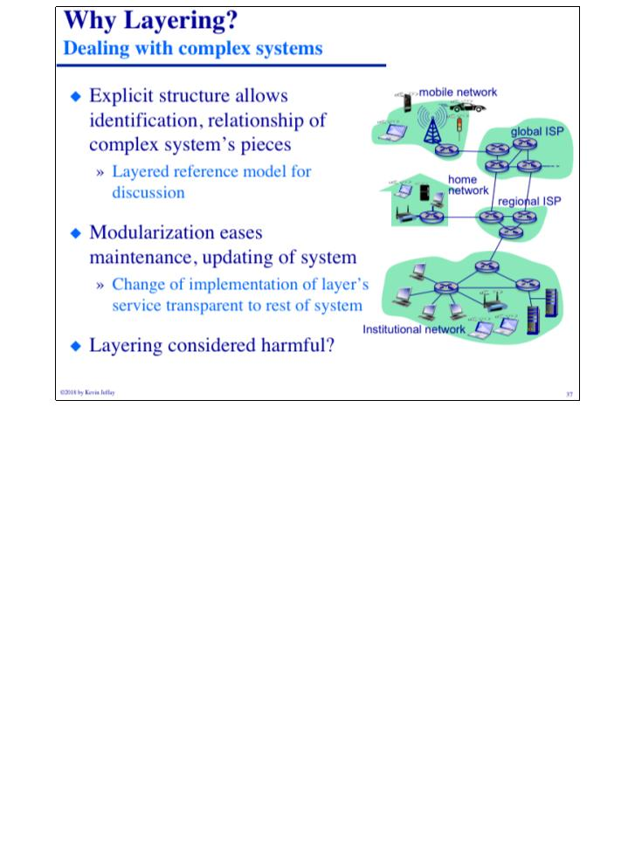
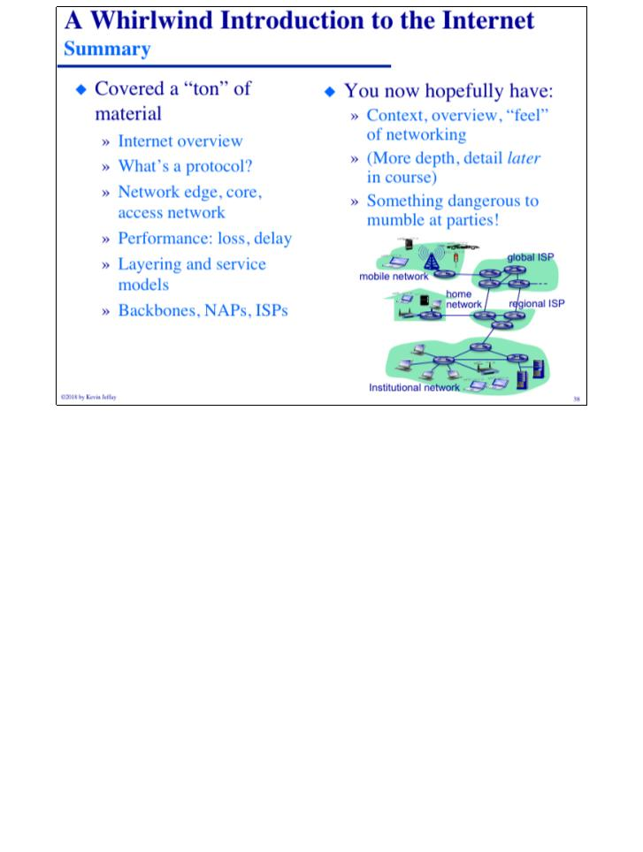
COMP 431
© 2018 by Kevin Jeffay
Lecture 2, Whirlwind Intro II
August 29, 2018
Page 37
COMP 431
© 2018 by Kevin Jeffay
Lecture 2, Whirlwind Intro II
August 29, 2018
Page 38

